Slide 1

Efficient Training Process for GANs
Authors: Matteo Cutroni (1918336)
Course: Computer Vision
Academic Year: 2025-2026
Notes:
‹#›

Slide 2
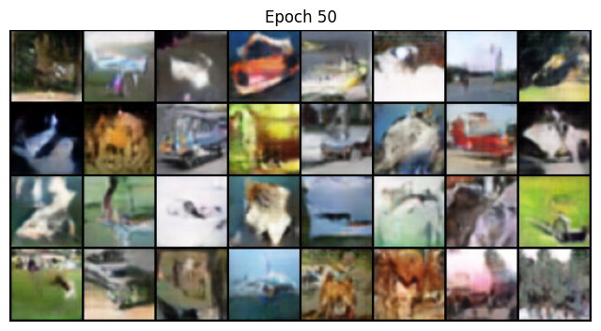
Outline
Problem Statement
State of the art
Proposed Method
Dataset
Experimental Setup
Results
Conclusions
Computer Vision
Pagina ‹#›/10
Notes:
‹#›

Slide 3
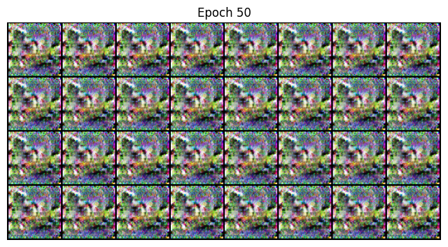
Problem Statement
Challenges:
Instability
GANs are prone to “Mode Collapse” and vanishing gradients
Data Scarcity
Training GANs typically requires over 50,000 images; using smaller datasets (e.g., 20%) can lead to overfitting.
Computer Vision
Pagina ‹#›/10

Slide 4
State of the art
Instability: R1 Gradient Penalty - Penalizes the Discriminator only
when gradients become unsafe, ensuring convergence without limiting the model's capacity.
Data Efficiency: DiffAugment - Applies differentiable transformations
(color, translation, cutout) to both Real and Fake images. This allows gradients to flow back through the augmentation to the Generator.
Computer Vision
Pagina ‹#›/10
Notes:
‹#›

Slide 5
Project Pipeline & Methodology
1. R1 Regularization
Changes from Standard DCGAN: Removed Batch Normalization; added the R1 gradient penalty.
Result: Solved numerical instability and vanishing gradients.
2. Data Efficiency: DiffAugment
Applied Differentiable Augmentation to Real & Fake batches.
Result: Forces learning of semantic features instead of pixel memorization.
3. Proposed Novelty: Adaptive Label Smoothing (ALS)
Linear Feedback Controller based on Discriminator confidence (D(x)).
  Unsure (D≈0.5): Target = 1.0 (Maximize Learning).
  Overfitting (D→1.0): Target → 0.8 (Apply Penalty).
Computer Vision

Slide 6
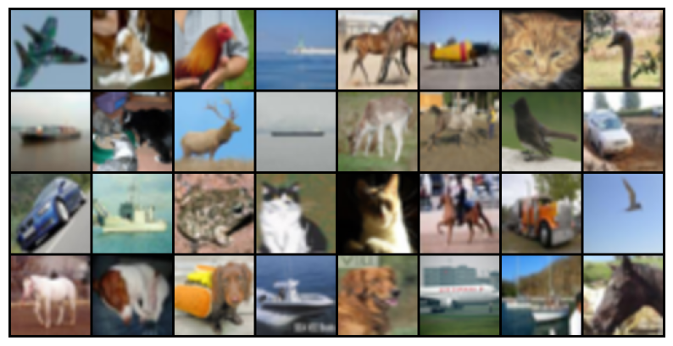
Dataset
CIFAR-10
Full Training: 50,000 images.
Limited Training: 10,000 images (Random 20% subset).
Computer Vision

Slide 7
Experimental Setup
1. Optimization Configuration
Baseline (Radford et al.): Adam Optimizer (α=0.0002, β1​=0.5, β2​=0.999).
Modernized & Limited Models: Adam Optimizer (α=0.0002, β1​=0.0, β2​=0.99).
  Reason: Reducing β1​ to 0.0 is a modern best practice (StyleGAN) to prevent oscillation.
2. Training Duration
Full Data: 50 Epochs × 50k images = 2.5M Images Processed.
Limited Data (20%): 250 Epochs × 10k images = 2.5M Images Processed.
Rationale: Matched the Total Images Seen (computational budget) across all experiments to ensure a scientifically fair comparison.
3. Evaluation Metric
Fréchet Inception Distance (FID): Measures the distance between feature distributions of real and generated images.
Computer Vision

Slide 8
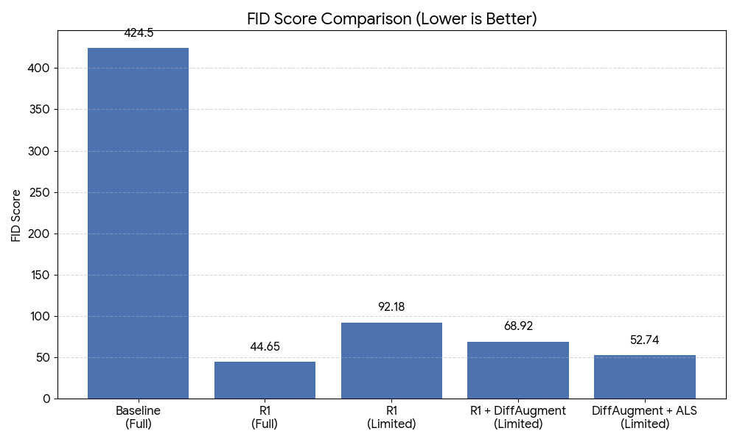
Model Evaluation
Computer Vision

Slide 9
Conclusions
Stability: Modern techniques (R1) are essential for DCGAN.
Efficiency: DiffAugment is the key enabler for limited data.
Novelty: Adaptive Label Smoothing outperforms R1 in data-scarce regimes (+23% improvement in FID).
Future Work: Combine ALS with stronger architectures like ResNet (StyleGAN).
Computer Vision

Slide 10
References
Radford, A., Metz, L., & Chintala, S. Unsupervised Representation Learning with Deep Convolutional Generative Adversarial Networks (2015).
Mescheder, L., Geiger, A., & Nowozin, S. Which Training Methods for GANs do actually Converge? (ICML 2018).
Zhao, S., Liu, Z., Lin, J., Zhu, J.Y., & Han, S. Differentiable Augmentation for Data-Efficient GAN Training(NeurIPS 2020).
Karras, T., Aittala, M., Hellsten, J., Laine, S., Lehtinen, J., & Aila, T. Training Generative Adversarial Networks with Limited Data (NeurIPS 2020).
Arjovsky, M., & Bottou, L. Towards Principled Methods for Training Generative Adversarial Networks (ICLR 2017).
Goodfellow, I., et al. Generative Adversarial Nets (NIPS 2014).
Computer Vision

